Slide 1
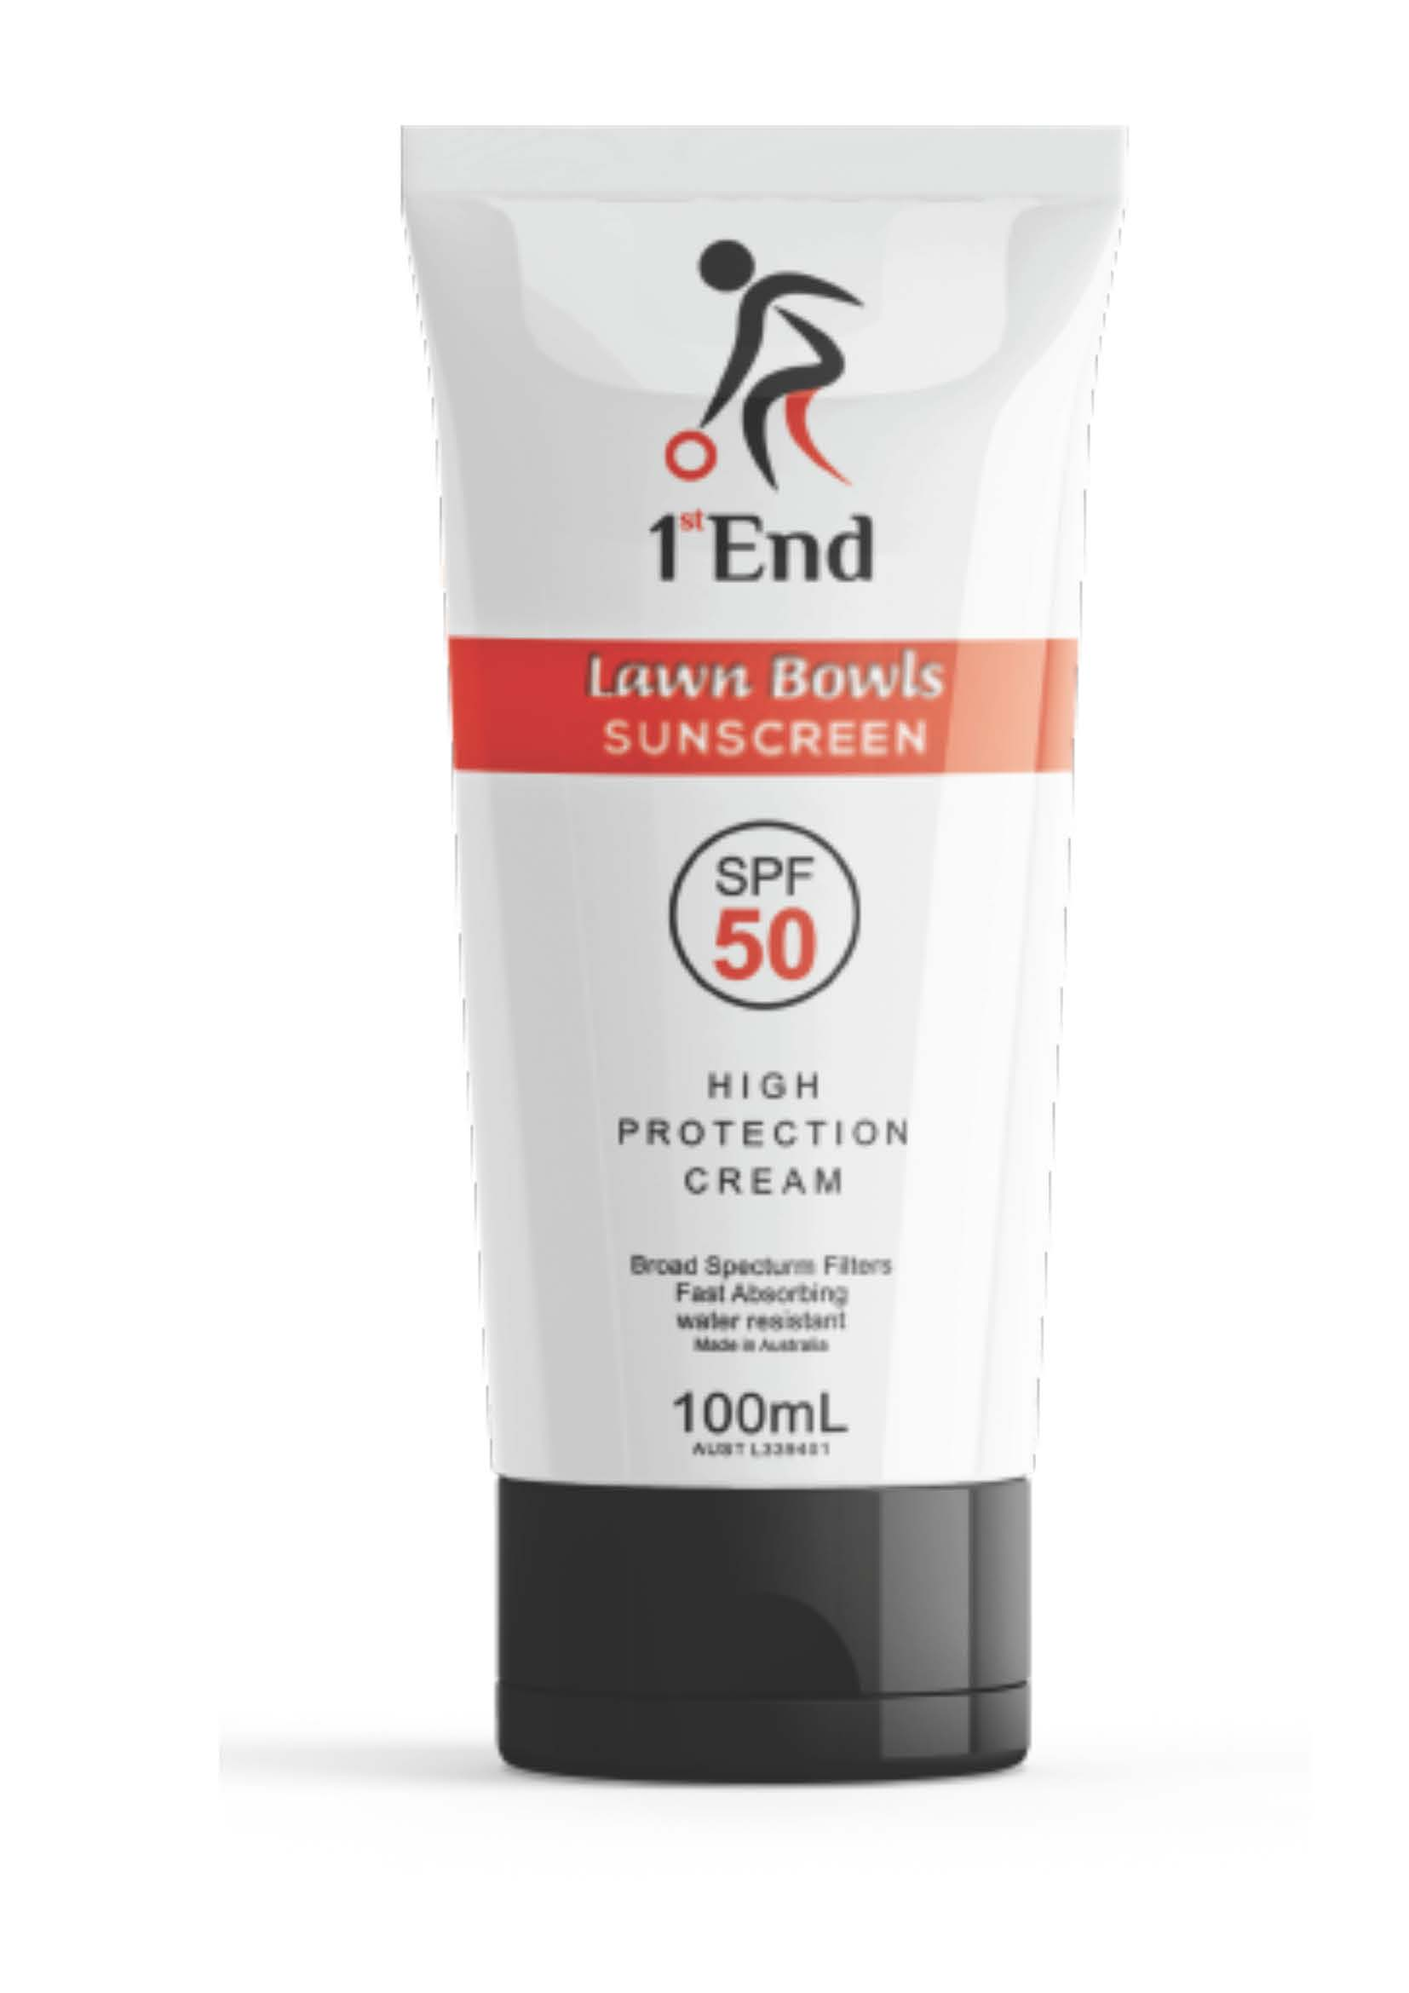
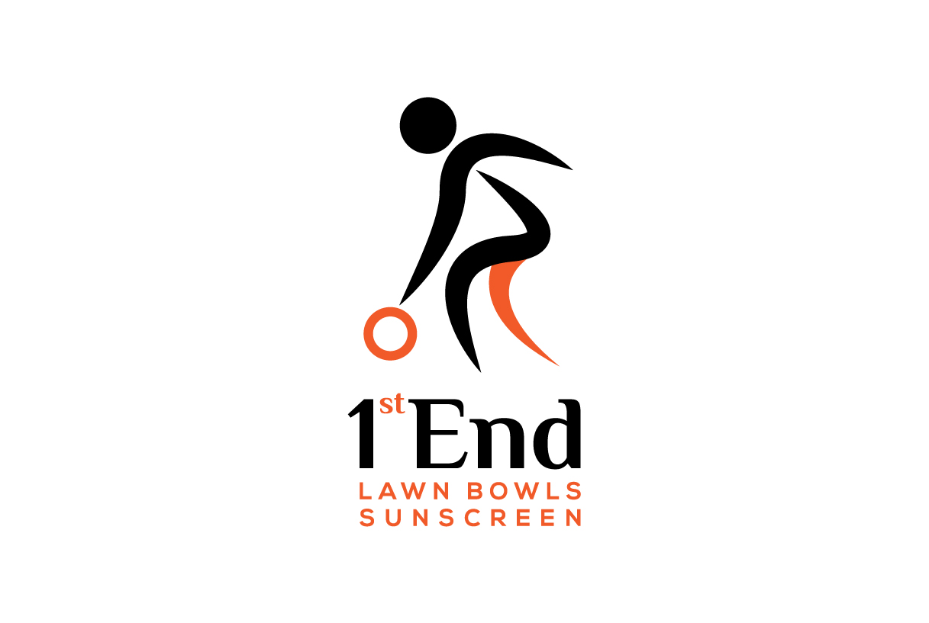
1st End Lawn Bowls Sunscreen
Sun Blessed Sunscreens

Slide 2
Did you know that in Australia:
Skin cancers account for around 80% of all newly-diagnosed cancers.
Doctors have almost 1 million patient consultations per year for skin cancer.
The incidence of skin cancer in Australia is one of the highest in the world, 2 to 3 times the rates in Canada, the US and the UK.

Slide 3
Now there is a quality Australian made sunscreen specifically formulated to protect those that love lawn bowls, from the sun’s harmful rays.
It’s time to stop using your every day, every use sunscreen’s and start using a sunscreen developed specifically for Lawn Bowls

Slide 4
Sun Blessed 1st End Lawn Bowls SPF50 broad spectrum sunscreen gives lawn bowlers the best possible protection for their skin when playing the game, they love.

Slide 5
To get your 1st End Lawn Bowls Sunscreen:
- Enquire at Toowoomba lawn bowls club
- visit us at; www.sunblessedsunscreens.com.au
- write to us at: hello@sunblessedsunscreens.com.au

